Slide 1
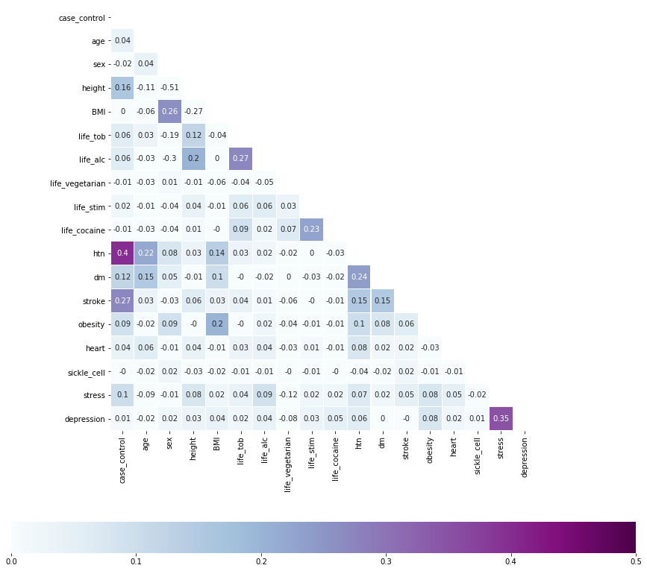
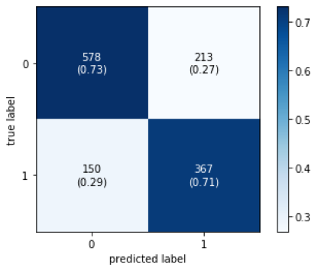
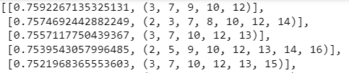
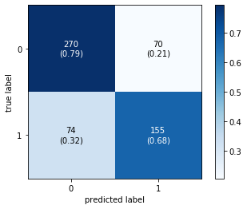
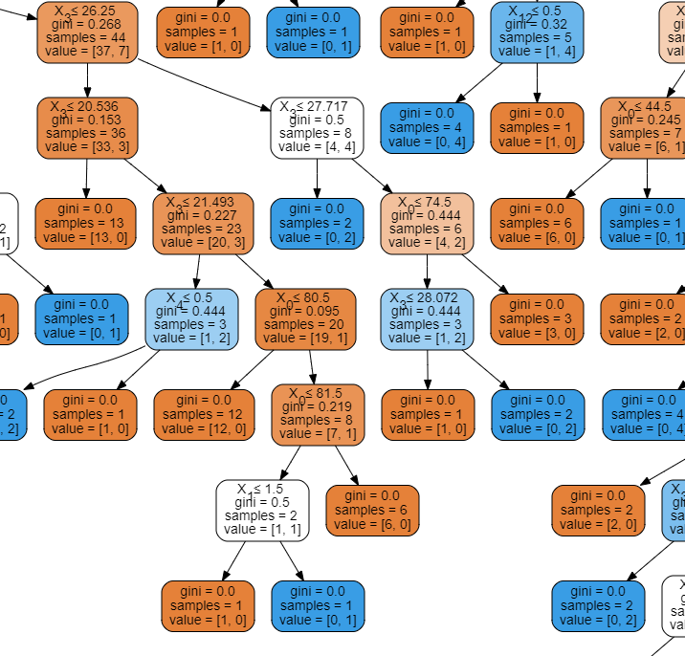
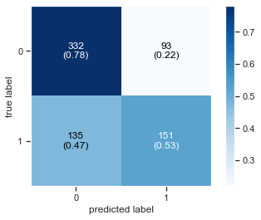
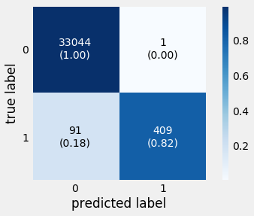
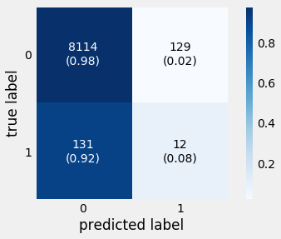
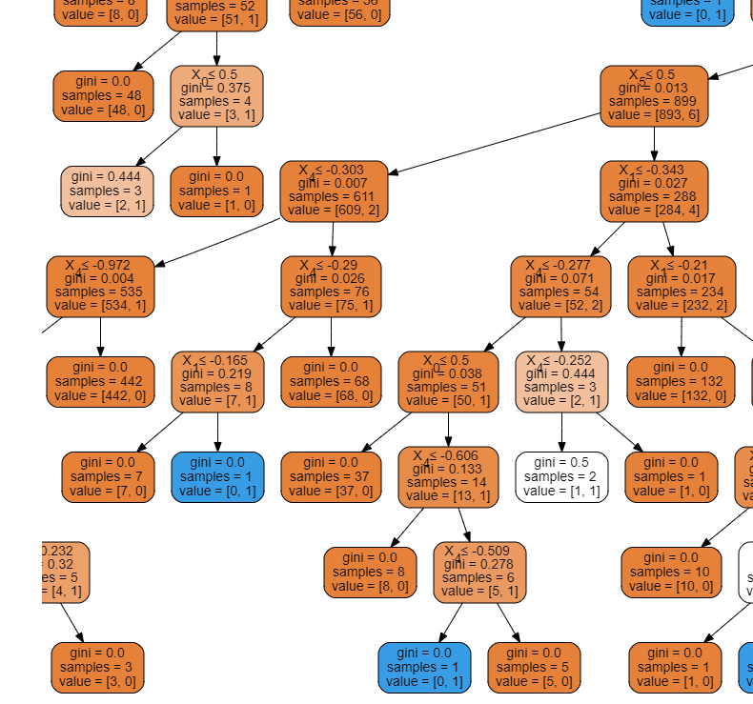
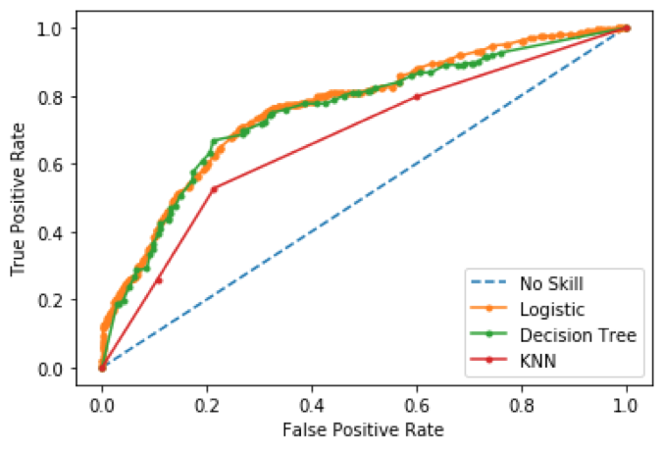
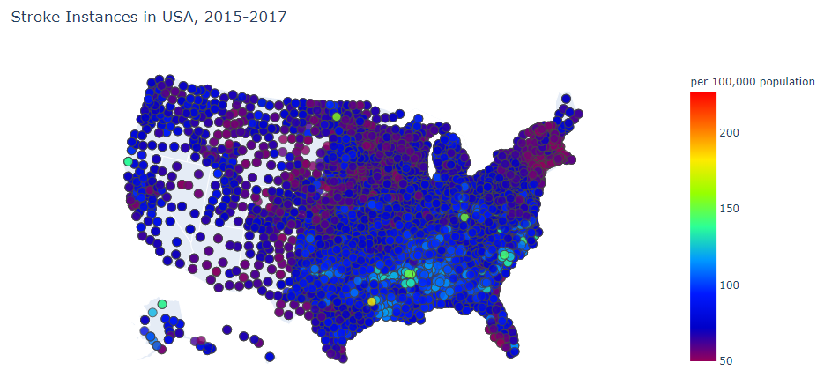
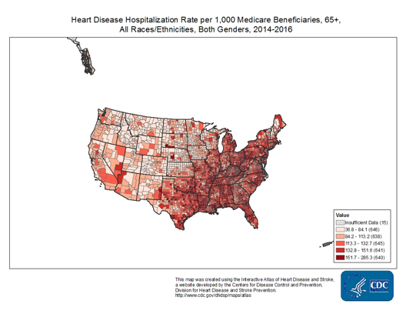
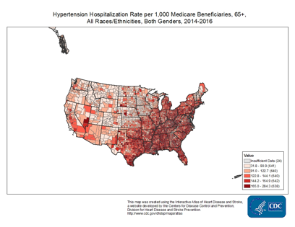
Prediction of Stroke in Sub-Saharan Africa/United States Group 16: Bruce Wen, Deirdre Edward, Isabelle Russo, Lynnette Jiang
Introduction
Aims
The incidence of stroke is rapidly increasing in low-income countries, particularly in Sub-Saharan Africa which has the “highest incidence, prevalence, and fatality” rates from stroke. However, few have studied the impact of risk factors specific for this region.
Based on more than 2,800 patients’ data from an unprecedented study on stroke in Nigeria and Ghana by the Stroke Investigative Research and Education Network (SIREN), we isolated what factors are most significant in the region. These included: hypertension, height, diabetes mellitus, stress, obesity, and heart problems. Keeping these factors in mind, we designed several algorithms to predict the incidence of stroke in Ghana and Nigeria, contrasting our results with the United States’ risk factors.
Test Different Machine Learning Classification algorithms to predict stroke accurately
Select best algorithm through training/testing on SIREN dataset to predict stroke in Sub-Saharan Africa
Visualize, geographically, publicly available stroke data and significant risk factors in the United States
Compare trained algorithms between datasets from the United States and Sub-Saharan Africa
Methodology
Datasets Utilized
Data Cleaning Flow
Classification Algorithms, Optimization, and Evaluation
CDC Stroke Mortality Data:
Stroke Mortality among US adults above 35 years old, 2015-2017 🡪 generate US stroke maps
Filter by County, Overall Stratification, and remove null values
Plot Geo-Scatters of Stroke Cases via plot.ly library
Classification Algorithms
Logistic Regression
Classification and Regression Trees (CART Decision Trees)
K Nearest Neighbors
Optimization Process
80% Training, 20% Testing
Select variables from PCC table OR Loop through Power Set of variables
SIREN Stroke Data:
Stroke data and 16 predictor variables for 2800+ patients in Nigeria and Ghana
Convert .sav to .csv format
Drop rows with missing values and binarize categorical variables
Kaggle US Stroke Data:
Stroke data and 10 predictor variables for ~43,000 patients in US
Evaluation of Algorithms
Accuracy Rate
Rate of True Positive and True Negative (Confusion Matrix)
Receiver Operating Characteristic (ROC) Curve
Binarize categorical variables
Standardize continuous variables
Results
Pearson Correlation Coefficient Table
Machine Learning Algorithms on SIREN dataset
Confusion Matrix for selected variables: Hypertension, height, history of stroke, stress, diabetes
Mean cross validation score: ???
Score without cv: ??
0.725
Top 5 Accuracy Rates among all Combinations of Variables
Confusion Matrix for selected variables: Hypertension, height, history of stroke, stress, diabetes, obesity, tobacco usage, heart disease
Mean cross validation score: 0.6225
Score without cv: 0.7467
Confusion Matrix for selected variables: Sex, height, vegetarian, stimulant, cocaine, hypertension, past instance of stroke, heart disease
Mean cross validation score: 0.7035
Score without cv: 0.7879
CART Decision Tree on US Kaggle dataset
Decision Tree (segment)
ROC Curve: Compare the 3 Optimized Algorithms
Mean cross validation score: 0.9634
Score without cv: 0.999
Confusion Matrix on Training Dataset. Selected Variables: Gender, Age, Hypertension, Heart Disease, BMI, tobacco user
Confusion Matrix on Testing Dataset. Same 6 variables
Decision Tree (segment)
US Stroke and Related Factors Maps
Plotted via plot.ly library. Data Source: CDC
Discussion and Conclusion
3 Machine Learning Algorithms were implemented, and optimized.
Algorithms were compared by accuracy rates (with/without Cross Validation), Confusion Matrix and ROC Curve.
CART Decision Tree and Logistic Regression both produced high True Positive and True Negative Rates, along with relatively high accuracy
Based on analysis, some important factors affecting stroke rates are: hypertension, history of stroke, height, heart disease, obesity
Relationships between some factors and stroke instances in the USA are visualized
Future Work
References
Note the low True Positive rate in the algorithm on US Kaggle dataset. The likely reason is the low number of stroke cases in the dataset relative to non-stroke cases. Changing the proportion could help increase the True Positive prediction accuracy. This could involve comparing data from SIREN dataset.
PCC may not be optimal for categorical variables. Attempt Spearman’s rank correlation coefficients.
Visualize African stroke distribution based on geography and time, when data is available.
Owolabi, M., Sarfo, F., Akinyemi, R., Gebregziabher, M., Akpa, O., Akpalu, A., … Ovbiagele, B. (2018). Dominant modifiable risk factors for stroke in Ghana and Nigeria (SIREN): a case-control study. The Lancet Global Health, 6(4). doi: 10.1016/S2214-109X(18)30002-0
Sanuade, O. A., Dodoo, F. N.-A., Koram, K., & Aikins, A. D.-G. (2019). Prevalence and correlates of stroke among older adults in Ghana: Evidence from the Study on Global AGEing and adult health (SAGE). Plos One, 14(3). doi: 10.1371/journal.pone.0212623
Yan, L. L., Li, C., Chen, J., Miranda, J. J., Luo, R., Bettger, J., … Wu, Y. (2016). Prevention, management, and rehabilitation of stroke in low- and middle-income countries. ENeurologicalSci, 2, 21–30. doi: 10.1016/j.ensci.2016.02.011
Notes:
Stretch the margin to the ends

